Slide 1
Coal Ash As Fill
Potential issues for NCDOT
    Coal ash has been used as fill across the state
    Where?
Department of Environmental Quality

Slide 2
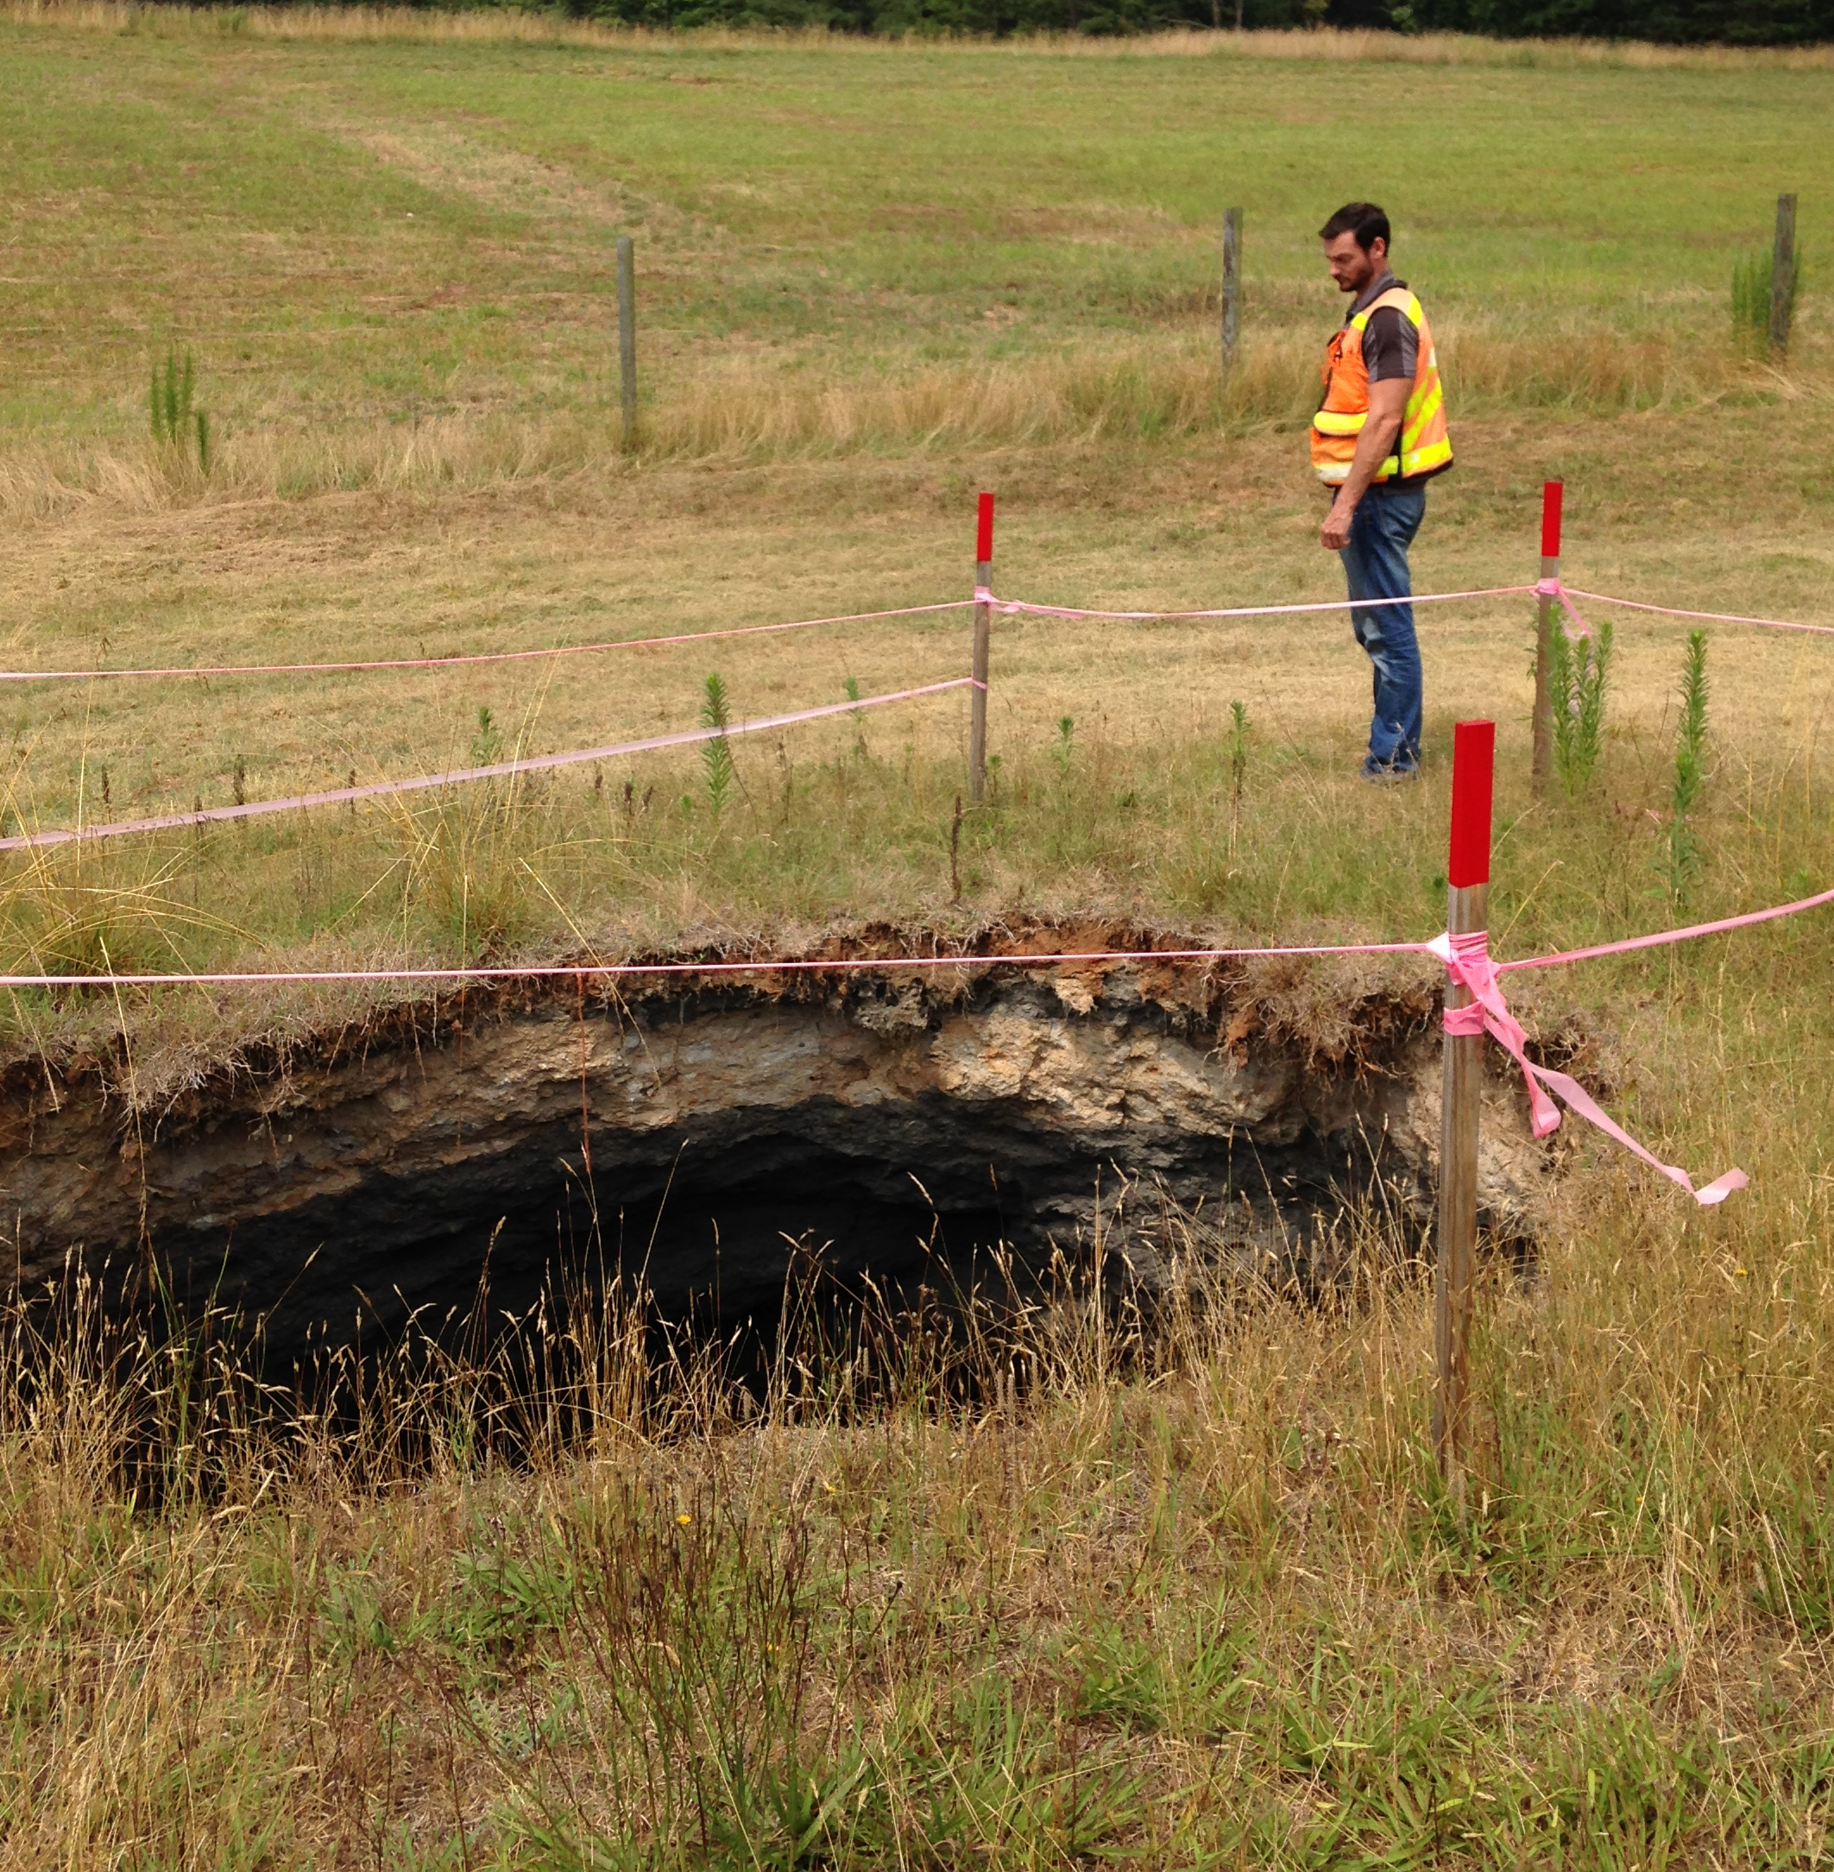
Hwy 16 Gaston County

Slide 3
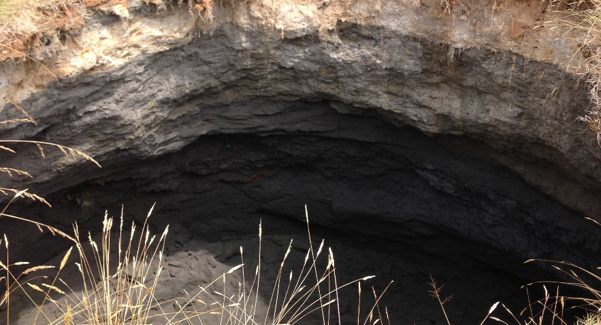
Hwy 16 in Gaston County

Slide 4
Coal Ash As Fill
Potential issues for NCDOT
NES created GIS shapefiles
Website for permitted coal ash fill:
http://deq.nc.gov/about/divisions/waste-management/solid-waste-section/coal-combustion-byproducts

